Slide 1
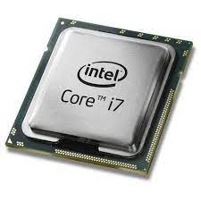
What is a Processor?
A Processor or Central Processing Unit (CPU) is an electronic circuit that can execute computer programs.
It is a logic circuit that responds to and processes the basic instructions that drive a computer.
The main and most crucial integrated circuit (IC) chip in a computer.

Slide 2
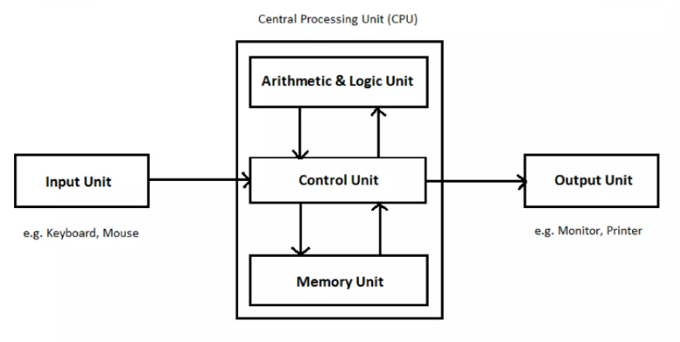
Components

Slide 3
Specifications
16-bits registers
8 general purpose registers (r0, …, r7)
Load new data.
Move data between registers
Addition/subtraction.

Slide 4
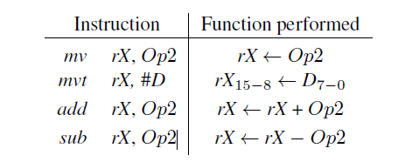
Instructions performed in the processor
The operand Op2 can be either a register, rY, or immediate data, #D.

Slide 5
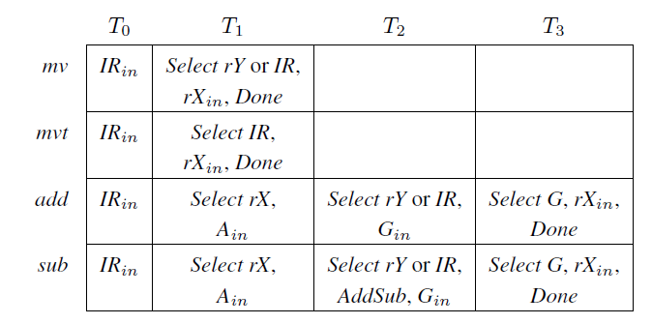
Control signals asserted in each instruction/time step

Slide 6
Instruction Encoding
Each instruction is encoded using a 16-bit format.
If Op2 specifies a register, then the instruction encoding is III0XXX000000YYY
III specifies the instruction, XXX gives the rX register, and YYY gives the rY register.
If Op2 specifies immediate data #D, then the encoding is III1XXXDDDDDDDDD
the field DDDDDDDDD represents a nine-bit signed (2’s complement) value.
Why do we need 3 bits for the instructions???

Slide 7
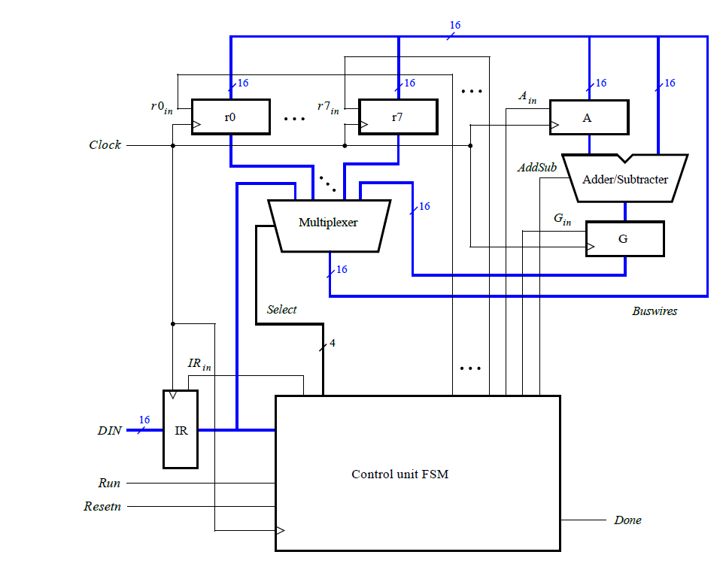
Today’s Lab – Simple Processor
16-bits registers
8 general purpose registers (r0, …, r7)
Load new data.
Move data between registers
Addition/subtraction.

Slide 8
Instruction Encoding
Instruction | Value of III
mv | 000
mvt | 001
add | 010
sub | 011

Slide 9
mv instruction (move)
Copies the contents of one register into another ➔ mv rX,rY
Initialize a register with immediate data ➔ mv rX,#D
D is represented using only nine bits
Sign-extend the data before loading it into register rX
i.e. D₈D₈D₈D₈D₈D₈D₈D₈−0

Slide 10
mvt instruction (move top)
Initialize the most significant byte of a register.
The instruction mvt rX,#D loads the 16-bit value D₇₋₀ 00000000 into rX.
Example: Load register r0 with the value 0xFF00 ➔ mvt r0,#0xFF.

Slide 11
add and sub instructions
add rX,rY ➔ produces the sum rX + rY and loads the result into rX.
add rX,#D ➔ produces the sum rX + D, where D is sign-extended to 16 bits, and saves the result in rX.
The sub instruction generates either rX − rY, or rX − #D and loads the result into rX.

Slide 12
Some instructions, such as an add or sub, take a few clock cycles to complete, because multiple transfers have to be performed across the bus.
FSM steps through instructions, asserting the control signals needed in successive clock cycles
The processor starts executing the instruction on the DIN input when the Run signal is asserted and the processor asserts the Done output when the instruction is finished.

Slide 13
Example
loads the number 28 into register r0 and then calculates, in register r1, the 2’s complement value −28.
mv r0, #28 // original number = 28
mvt r1, #0xFF
add r1, #0xFF // r1 = 0xFFFF
sub r1, r0 // r1 = 1’s-complement of r0
add r1, #1 // r1 = 2’s-complement of r0 = -28

Slide 14
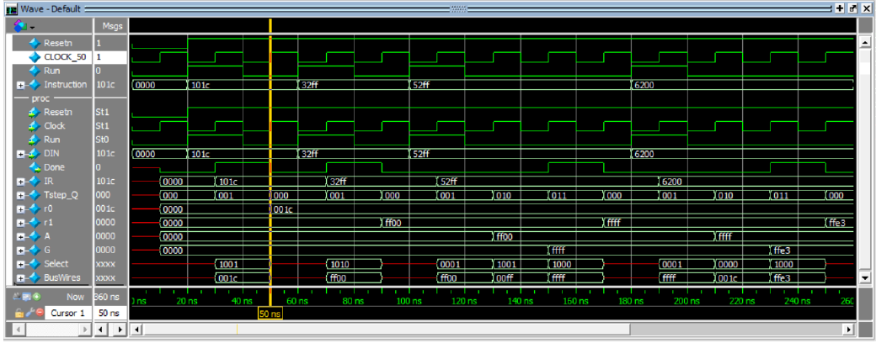
Simulation results for the processor

